Slide 1


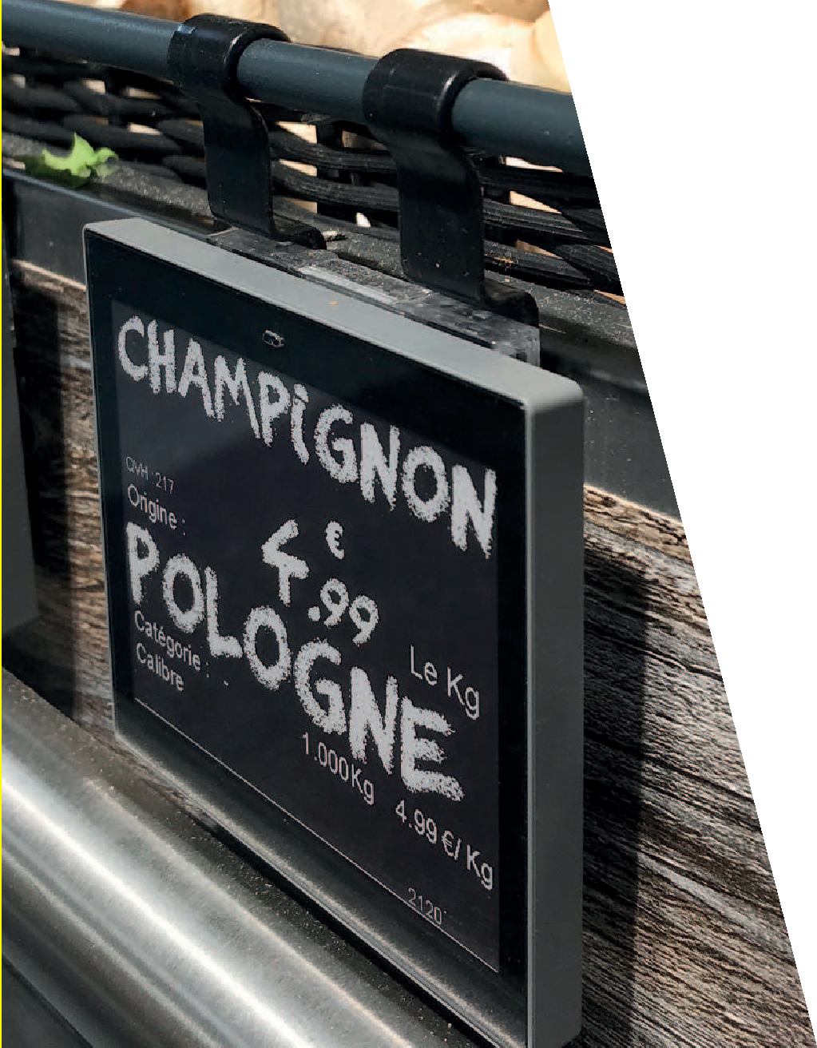
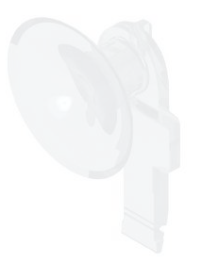
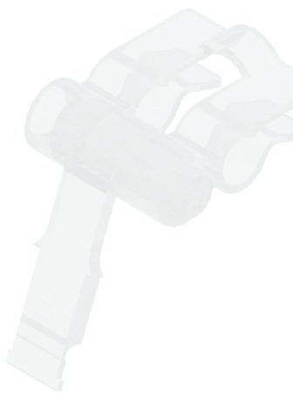
ESL ACCESSORIES
For “NEWTON” electronic labels
In this catalog you will find the widest variety of accessories designed specifically for the “NEWTON ESL SOLUM”
All the accessories are specifically designed to be applied with each electronic label model.
CATALOGUE
20
23

Slide 2

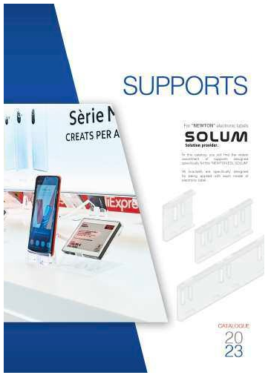
In this catalog you will find the widest variety of accessories designed specifically for the “NEWTON ESL SOLUM”.
All the accessories are specifically designed to be applied with each electronic label model.
CATALOGUES
See our “supports” and “shelf profiles” catalogs, where you will find the widest assortment of items designed specifically for solum newton electronic labels.
Most of them have inserts that, in combination with our supports, allow each label model to be displayed in different positions so that they adapt to any type of furniture or surface, adapting to any situation you need in your business.
In cases where these accessories come into contact with food, the materials with which they have been manufactured are especially for food use.
If you do not find the product you need, contact us and we will develop it in the shortest possible time.
SHELF PROFILES
Our catalog represents a large assortment of profiles for the different types of shelves on the market.
INDEX
ACCESSORIES OVA
FOR NEWTON ELECTRONIC LABELS
PAGE
06
Inclined support for Solum 6.0 Labels and 7.5 horizontal and vertical position
If the profile you need is not in this catalog, we can develop it in a short period of time.
08
Magnetic clip with 2 mm neodymium magnet
10
12
Clip to hang with wire or cable Suction cup clip front position
We keep a permanent stock of all referenced models in lengths of 985 and 1315 mm and in transparent and black COLORS.
14
16
Suction cup clip back position
Hanging hook for rods up to ø 8 mm Hanging hook for rods up to ø 12 mm
All our profiles are made of a single piece; that is, they are inserted directly into the front of the shelf without requiring any assembly or other manipulations.
18
Hanging hook universal ovl model
19
Cross hanging hook for rods from ø 3 to 6 mm cho model 3.6 Cross hanging hook for rods from ø 5 to 8 mm cho modelo 5.8
SUPPORTS
20
Boomerang model support for solum labels 1.6, 2.2, 2.6, 2.7 And 2.9. 35 Mm bar
Boomerang model support for solum labels 1.6, 2.2, 2.6, 2.7 And 2.9. Bar of 55 mm bar
In this catalog you will find the widest assortment of supports designed specifically for the “NEWTON ESL SOLUM”.
21
22
Boomerang model support for solum labels
1.6, 2.2, 2.6, 2.7, 2.9 And 4.2 Bar of 110 mm bar
Support and hooks for hanging solum 11.6 Labels on over- head rail
All holders are specifically designed for your application with each electronic tag model.
Most have inserts that, in combination with our accessories, allow each label model to be displayed in different positions to adapt to any type of furniture and surface, adapting to any situation that you need in your store.
24
25
Connection piece to join two sections of aluminum overhead profile
In cases where these supports come into contact with food, the materials with which they have been manufactured are special for food use.
26
28
Profile for hanging large format labels Angular connector clip
Stand clip to adjust the inclination of the labels
If you do not find the support you need, contact us and we will develop it in the shortest possible time.
29
Tilt regulator with rods for supports
For esl solum 6.0 And 7.5 Standard size

Slide 3

Newton Localization System
Accessories for electronic labels So
4
lum / Catalogue 2023
Accessories for electronic labels Solum / Catalogue 2023
5
30
Double connecting rods
Base for double connected rods
INDEX
ACCESSORIES OVA
FOR NEWTON ELECTRONIC LABELS
31
32
Base with tilting bar and adjustable height Metal base with fixed bar and adjustable height
33
Metal base with telescopic bar
34
36
Base with adjustable slope for small format supports Edge clip
Newton incorporates its own label positioning system that makes it easier for Managers,
staff and customers to find the right location of a product.
36
Edge clip with angular connector clip
37
38
Clip for tubes and rods of ø 5, 10, 15 and 30 mm Clip for rods and rod hooks from ø 4 to 6 mm
39
40
Clip for shelves from 8 to 18 mm thick
Clip for glass shelves from 8 to 10 mm thick with anti-slip rubber
41
Clips for shelves from 8 to 18 mm width
42
43
Universal clip for shelves 5 to 30 mm thick
Universal clip to place promotional supplements 2-Position connector with strong grip adhesive
44
1-Position connector with foamed adhesive Electronic label remover tool
45
46
Hanging hook with 9 mm connector
Hanging hook for pipes up to ø 20 mm with 9 mm connector
47
48
Swing clip for tegometall shelves with 9 mm connector Double joint gripper
49
Omniclipper® model gripper
50
51
Unniclipper® model gripper with rotating and adjustable rod
Unniclipper® model gripper with rotating and adjustable tube with device for supports with inserts
52
Gripper for boxes and baskets up to 15 mm thick with rotating and adjustable rod
53
Gripper for boxes and baskets up to 15 mm thick With device for supports with inserts
Magnum model telescopic tube
With extendable bar from 1000 to 1900 mm
The most competitive solution in terms of costs,
as you do not need any additional infrastructure or a different server.
54
55
Nemo model telescopic tube with extendable bar with device for supports with inserts
Metal bases for nemo telescopic tube
Promo system
Now, it’s easier for managers and staff to navigate and locate what products need
to be replenished.
56
Customers can locate the product from their mobile devices.

Slide 4
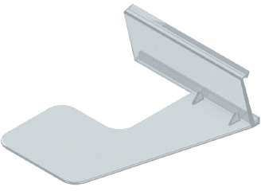
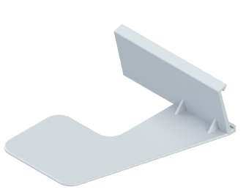
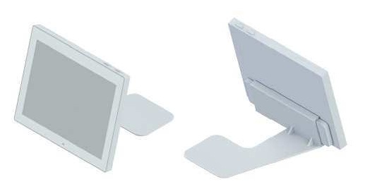
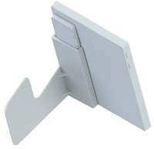
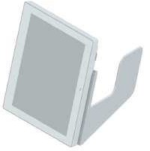
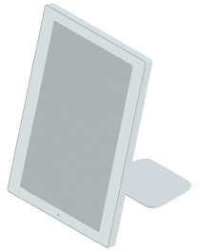
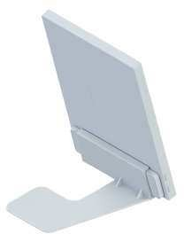
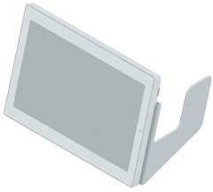
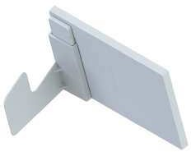
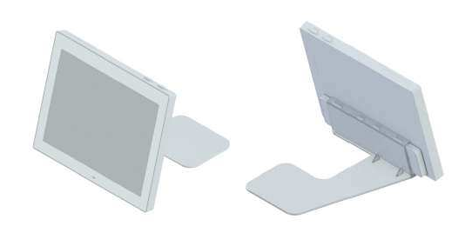
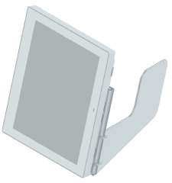
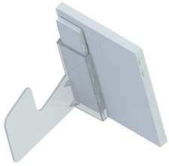
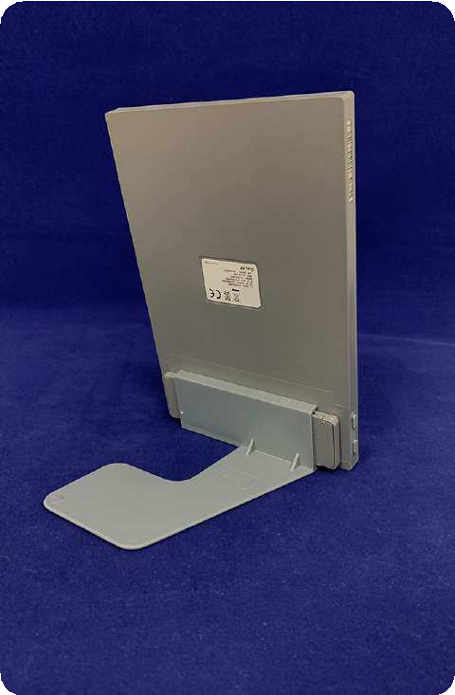
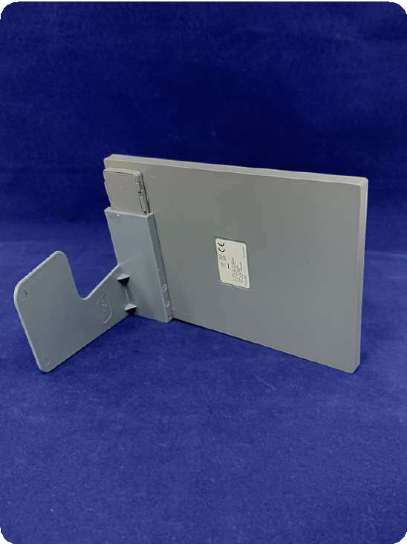
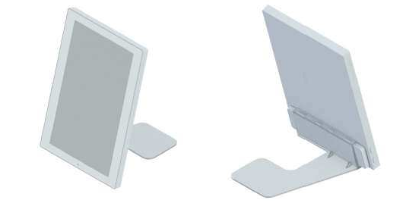
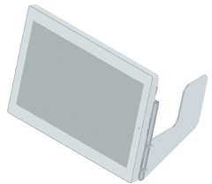
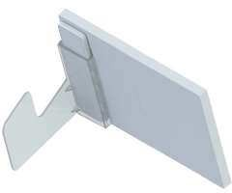
Accessories for electronic labels Solum / Catalogue 2023
Accessories for electronic labels Solum / Catalogue 2023
INCLINED SUPPORT FOR 6.0 AND 7.5 SOLUM ESL
01802-08
APLICATION
6.0”
CODE | LABELS | COLOR | MATERIAL
01800-00 | 6.0 / 7.5 | Transparent | Polycarbonate
01802-08 | 6.0 / 7.5 | Grey Ral 7012 | ABS
Box units: 25 supports.
Minimum order: 1 box.
01800-00
APLICATION
7.5”
6.0”
7.5”
6
7

Slide 5
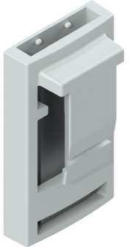
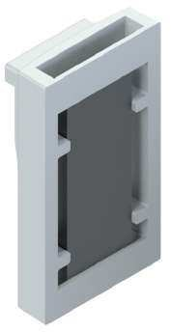
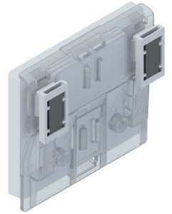
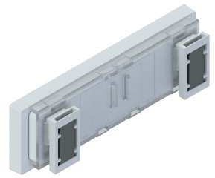
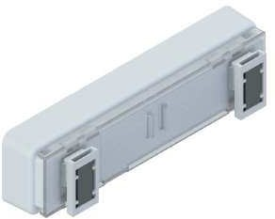
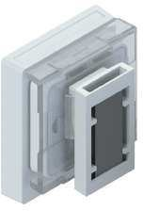
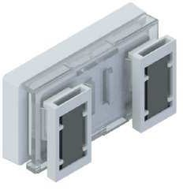
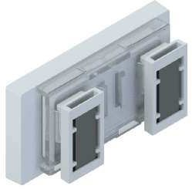
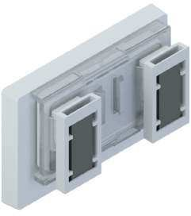
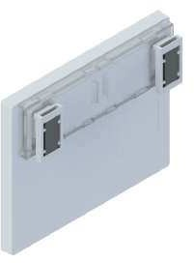
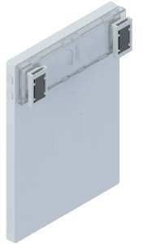
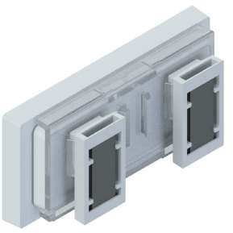
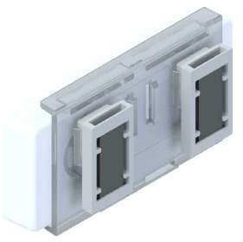
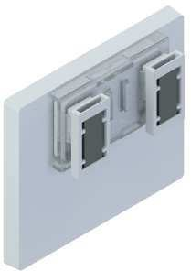
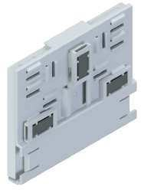
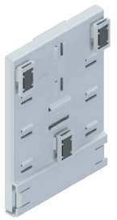
Accessories for electronic labels Solum / Catalogue 2023
Accessories for electronic labels Solum / Catalogue 2023
MAGNETIC CLIP WITH 2 MM NEODYMIUM MAGNET
01850-00
APLICATION
4.2”
CODE LABELS COLOR MATERIAL
01850-00
01850-08
Can be attached to all supports of the program.
Transparent Polycarbonate GREY RAL 7012 Polycarbonate
Box units: 20
Minimum order: 1 box.
01850-00
APLICATION
4.3”
4.3” Industrial
1.6”
2.2”
2.6”
2.7”
2,9”
2.9” Metro / Makro labels
6.0” (reduced size support)
7.5” (reduced size support)
4.2” (reduced size support)
6.0” (standard size support)
7.5” (standard size support)
8
9

Slide 6
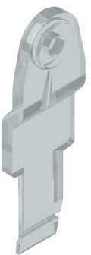
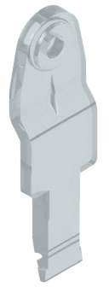
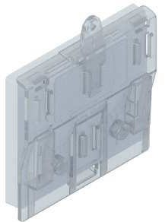
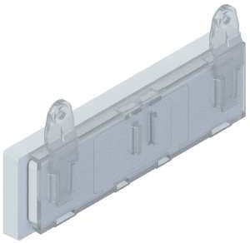
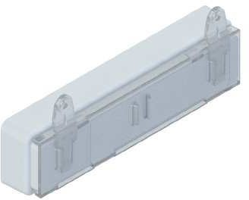
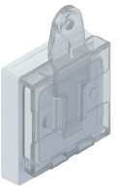
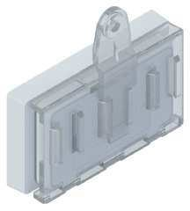
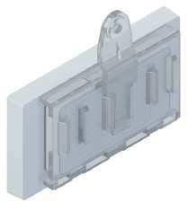
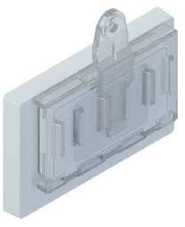
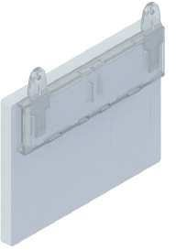
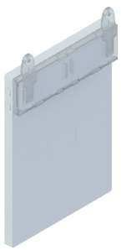
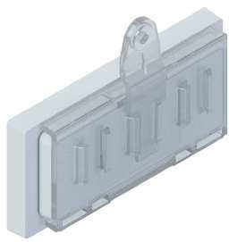
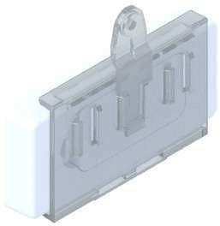



Accessories for electronic labels Solum / Catalogue 2023
Accessories for electronic labels Solum / Catalogue 2023
HANGING CLIP WITH WIRE OR CABLE FOR ESL SOLUM
01850-00
APLICATION
4.2”
CODE LABELS COLOR MATERIAL
01860-00
Can be attached to all supports of the program.
Transparent Polycarbonate
Box units: 20
Minimum order: 1 box.
01860-00
APLICATION
4.3”
4.3” Industrial
1.6”
2.2”
2.6”
2.7”
2,9”
2.9” Metro / Makro labels
6.0” (reduced size support)
7.5” (reduced size support)
4.2” (reduced size support)
6.0” (standard size support)
7.5” (standard size support)
10
11

Slide 7























Accessories for electronic labels Solum / Catalogue 2023
Accessories for electronic labels Solum / Catalogue 2023
SUCTION CUP CLIP FRONT POSITION
01870-00
APLICATION
4.2”
CODE LABELS COLOR MATERIAL
01870-00
Can be attached to all supports of the program.
Transparent Polycarbonate
Box units: 20
Minimum order: 1 box.
01870-00
APLICATION
4.3”
4.3” Industrial
1.6”
2.2”
2.6”
2.7”
2,9”
2.9” Metro / Makro labels
6.0” (reduced size support)
7.5” (reduced size support)
4.2” (reduced size support)
6.0” (standard size support)
7.5” (standard size support)
12
13

Slide 8













Accessories for electronic labels Solum / Catalogue 2023
Accessories for electronic labels Solum / Catalogue 2023
SUCTION CUP CLIP BACK POSITION
01880-00
APLICATION
4.2”
CODE LABELS COLOR MATERIAL
01880-00
Can be attached to all supports of the program.
Transparent Polycarbonate
Box units: 20
Minimum order: 1 box.
01880-00
APLICATION
4.3”
4.3” Industrial
1.6”
2.2”
2.6”
2.7”
2,9”
2.9” Metro / Makro labels
6.0” (reduced size support)
7.5” (reduced size support)
4.2” (reduced size support)
6.0” (standard size support)
7.5” (standard size support)
14
15

Slide 9


















Accessories for electronic labels Solum / Catalogue 2023
Accessories for electronic labels Solum / Catalogue 2023
HANGING HOOK FOR Ø 8 mm RODS
01890-00 / 01896-00 / 01900-00 / 01996-05
APLICATION
4.2” (reduced size support)
4.2”
CODE LABELS COLOR MATERIAL
01890-00 Can be attached to Transparent 01896-05
Polycarbonate Acetal
all supports of the program.
Black
Box units: 20
Minimum order: 1 box.
HANGING HOOK FOR Ø 12 mm RODS
4.3”
4.3” Industrial
CODE LABELS COLOR MATERIAL
01900-00
01996-05
Can be attached to all supports of the program.
Transparent Black
Polycarbonate Acetal
Box units: 20
Minimum order: 1 box.
01890-00 / 01896-00 / 01900-00 / 01996-05
APLICATION
1.6” 2.2”
2.6”
2.7”
6.0” (reduced size support)
7.5” (reduced size support)
2,9”
2.9” Metro / Makro labels
6.0” (standard size support)
7.5” (standard size support)
16
17

Slide 10

























Accessories for electronic labels Solum / Catalogue 2023
Accessories for electronic labels Solum / Catalogue 2023
HANGING HOOK UNIVERSAL OVL MODEL
CHO MODEL CROSS HANGER HOOK WITH THREE DEGREES OF INCLINATION FOR RODS FROM Ø 3 TO 6 MM
CODE | LABELS | COLOR | MATERIAL
02010-00 | Samll & Medium | Transparent | Polycarbonate
CODE LABELS COLOR MATERIAL
Box units: 100
Minimum order: 1 box.
02000-00 Can be attached to
all supports of the program.
Transparent Polycarbonate
Box units: 100
Minimum order: 1 box.
CHO MODEL CROSS HANGER HOOK WITH THREE DEGREES OF INCLINATION FOR RODS FROM Ø 5 TO 8 MM
02000-00
APLICATION
CODE | LABELS | COLOR | MATERIAL
02020-00 | Samll & Medium | Transparent | Polycarbonate
Box units: 100
Minimum order: 1 box.
02010-00 / 02020-00
APLICATION
T-Hook Attachment Fits Short Top, Axial, or Bottom Rod Hooks Rod.
T-Hook Attachment Fits Short Top, Axial, or Bottom Rod Hooks Rod.
Short top rod
Short axial rod
Short bottom rod
It allows you to adjust the inclination according to the height at which the label is placed so that it is always facing the customer.
Short top rod Short axial rod Short bottom rod
It allows you to adjust the inclination according to the height at which the label is placed so that it is always facing the customer.
REAR tilt
for labels placed in levels of high exposure
NO INCLINATION
for labels located at eye level
FRONT tilt
for labels placed in levels of low exposure
REAR tilt
for labels placed in levels of high exposure
NO INCLINATION
for labels located at eye level
FRONT tilt
for labels placed in levels of low exposure
18
19

Slide 11
















Accessories for electronic labels Solum / Catalogue 2023
Accessories for electronic labels Solum / Catalogue 2023
BOOMERANG MODEL SUPPORT BAR OF 35 MM IN HEIGHT
BOOMERANG MODEL SUPPORT BAR OF 55 MM IN HEIGHT
CODE
LABELS
COLOR
MATERIAL
CODE
LABELS
COLOR
MATERIAL
02030-00
02036-05
1.6 / 2.2 / 2.6 / 2.7 / 2.9
1.6 / 2.2 / 2.6 / 2.7 / 2.9
Transparent Black
Polycarbonate Acetal
02040-00
02046-05
1.6 / 2.2 / 2.6 / 2.7 / 2.9
1.6 / 2.2 / 2.6 / 2.7 / 2.9
Transparent Black
Polycarbonate Acetal
Box units: 25
Minimum order: 1 box.
Box units: 25
Minimum order: 1 box.
02030-00
APLICATION
02040-00
APLICATION
02036-05
APLICATION
02046-05
APLICATION
20
21

Slide 12










Accessories for electronic labels Solum / Catalogue 2023
Accessories for electronic labels Solum / Catalogue 2023
BOOMERANG MODEL SUPPORT BAR OF 110 MM IN HEIGHT
CODE | LABELS | COLOR | MATERIAL
02050-00 | 1.6 / 2.2 / 2.6 / 2.7 / 2.9 / 4.2 | Transparent | Polycarbonate
02056-05 | 1.6 / 2.2 / 2.6 / 2.7 / 2.9 / 4.2 | Black | Acetal
Box units: 25
Minimum order: 1 box.
02050-00
APLICATION
02056-05
APLICATION
22
23

Slide 13
















Accessories for electronic labels Solum / Catalogue 2023
Accessories for electronic labels Solum / Catalogue 2023
SUPPORT AND HOOKS FOR HANGING SOLUM 11.6 LABELS ON OVERHEAD RAIL
CONNECTION PIECE TO JOIN TWO SECTIONS OF ALUMINUM OVERHEAD PROFILE
CODE | LABELS | COLOR | MATERIAL
02062-08 | 1.6 | Grey 7012 | ABS |  | CODE | COLOR | MATERIAL
02070-00 | 1.6 | Transparent | Polycarbonate |  | 02106-05 | Black | ABS
02080-00* | 1.6 | Transparent | Polycarbonate |  |  |  | Box units: 4
Box units: 20
Minimum order: 1 box.
*Available soon
Minimum order: 1 box.
02062-08
APLICATION
CLOSING CAP FOR THE ENDS OF THE ALUMINUM OVERHEAD PROFILE
CODE | COLOR | MATERIAL
02110-05 | Black | ABS
Box units: 2
Minimum order: 1 box.
Box units: 5
Minimum order: 1 box.
02070-00
APLICATION
02080-00
APLICATION
Box units: 50
Minimum order: 1 box.
02080-00
APLICATION
Box units: 50
Minimum order: 1 box.
24
25

Slide 14




Accessories for electronic labels Solum / Catalogue 2023
Accessories for electronic labels Solum / Catalogue 2023
PROFILE FOR HANGING LARGE FORMAT LABELS
CODE | COLOR | LENGTH | MATERIAL
 |  | (mm)
PEE-1901 | White
PEE-1902 | Red Ral 3028
PEE-1903 | Blue Ral 5005
PEE-1904 PEE-1905 | Green Ral 6024 Black | 2000 | Aluminum
PEE-1955 | Anodized Silver
PEE-1966 | Light Oak
PEE-1967 | Dark Oak
32 mm
52 mm
We can manufacture the profiles in other anodized finishes and colors.
Box units: 20
Minimum order: 1 box.
CLOSING CAPS FOR OVERHEAD RAIL
02116-08
PROFILE SECTION
CONNECTION CAPS BETWEEN OVERHEAD RAIL
02106-08
PROFILE SECTION
CLOSING CAPS FOR OVERHEAD RAIL
02116-08
TWO-SIDED HOOK FOR HANGING 11.6 LABELS
02080-00
ONE-SIDED HOOK FOR HANGING 11.6 LABELS
0270-00
26
27

Slide 15
















Accessories for electronic labels Solum / Catalogue 2023
ANGULAR CONNECTOR CLIP
It provides different angles of inclination on accessories that require the use of this connector.
Essential for the stand clip, double connecting rods, omniclipper® clamps, uniclipper® clippers and clippers for boxes and baskets.
Accessories for electronic labels Solum / Catalogue 2023
120 MM RODS TO TILT THE STANDARD SIZE SUPPORTS FOR ESL SOLUM 6.0 AND 7.5
Angular connector needed (not included)
CODE COLOR MATERIAL
02300-01
02300-05
White Black
Acetal Acetal
CODE
LABELS
COLOR
MATERIAL
Box units: 50
Minimum order: 1 box.
02325-01
02325-05
6.0 / 7.5
White Black
Acetal Acetal
STAND CLIP TO ADJUST THE INCLINATION OF THE LABELS
Angular connector needed (not included)
Box units: 20
Minimum order: 1 box.
02325-01
APLICATION
CODE LABELS COLOR MATERIAL
02305-01
02305-05
1.6 / 2.2 / 2.6 / 2.7
/ 2.9 / 4.2
White Black
Acetal Acetal
Box units: 20
Minimum order: 1 box.
02305-01
APLICATION
02325-05
APLICATION
02305-05
APLICATION
28
29

Slide 16














Accessories for electronic labels Solum / Catalogue 2023
DOUBLE CONNECTION RODS
They allow the supports and accessories that require the use of these rods to be displayed at different heights.
Accessories for electronic labels Solum / Catalogue 2023
BASE WITH TILTING BAR AND ADJUSTABLE HEIGHT (LENGTH: 200MM)
Must-have for adding standard size supports to esl newton 6.0 And 7.5 Supports, rod bases, omniclipper® clamps, and clamps for boxes and baskets.
TRANSPARENT | WHITE | BLACK | LENGTH (MM)
02310-00 | 02310-01 | 02310-05 | 10
02315-00 | 02315-01 | 02315-05 | 35
02320-00 | 02320-01 | 02320-05 | 60
02325-00 | 02325-01 | 02325-05 | 120
02330-00 | 02330-01 | 02330-05 | 170
CODE LABELS COLOR MATERIAL
02605-00
Can be attached to all supports of the program.
Black Polycarbonate
Box units: 20
Minimum order: 1 box.
Box units: 20
Minimum order: 1 box.
02605-00
APLICATION
BASE FOR DOUBLE CONNECTION RODS
RODS NOT INCLUDED
CODE LABELS COLOR MATERIAL
02600-00
02600-05
Can be attached to all supports of the program.
Transparent Black
Polycarbonate Polycarbonate
Box units: 20
Minimum order: 1 box.
02600-00 / 02600-05
APLICATION
30
31

Slide 17

















Accessories for electronic labels Solum / Catalogue 2023
Accessories for electronic labels Solum / Catalogue 2023
METAL BASE WITH FIXED BAR AND ADJUSTABLE HEIGHT
Special for hot surfaces
METAL BASE WITH TELESCOPIC BAR
METAL COLOR
COLOR BLACK
LABELS
BAR HEIGHT (MM)
CODE
LABELS
COLOR
BAR HEIGHT (MM)
02610-20
02615-20
02610-05 *
02615-05 *
100
185
02620-05
02625-05
1.6 / 2.2 / 2.6 / 2.7 / 2.9 /
2.9 Metro / Makro
4.2 / 4.3 / 4.3 industrial
6.0 / 7.5 reduced size
Black
150 < 250
250 < 400
1.6 / 2.2 / 2.6 / 2.7 / 2.9 / 2.9
Metro / Makro
4.2 / 4.3 / 4.3 industrial
6.0 / 7.5 reduced size
Box units: 20
Minimum order: 1 box.
Box units: 20
Minimum order: 1 box.
02610-20 / 02610-05
APLICATION
02620-05
APLICATION
02615-20 / 02615-05
APLICATION
02625-05
APLICATION
32
33

Slide 18














Accessories for electronic labels Solum / Catalogue 2023
Accessories for electronic labels Solum / Catalogue 2023
BASE FOR SMALL FORMAT SUPPORTS WITH ADJUSTABLE INCLINATION
CLIP FOR EDGE FROM 1 TO 6 MM
CODE COLOR LABELS MATERIAL
CODE LABELS COLOR MATERIAL
02631-00 Transparent
1.6 / 2.2 / 2.6 / 2.7 / 2.9 / 2.9
Metro / Makro
Polycarbonate
02340-01
02340-05
Can be attached to all the supports of the program.
White Black
Acetal Acetal
Box units: 20
Minimum order: 1 box.
Box units: 100
Minimum order: 1 box.
02631-00
APLICATION
CLIP FOR EDGE FROM 1 TO 12 MM
CODE LABELS COLOR MATERIAL
02345-01
02345-05
Can be attached to all the supports of the program.
White Black
Acetal Acetal
Box units: 100
Minimum order: 1 box.
02340-01 / 02340-05 / 02345-01 / 02345-05
APLICATION
34
35

Slide 19
























Accessories for electronic labels Solum / Catalogue 2023
Accessories for electronic labels Solum / Catalogue 2023
EDGE CLIP WITH ANGLE ADAPTER FROM 1 TO 6 MM
Rod max. ø 5 mm
CLIP FOR TUBES AND RODS OF Ø 5, 10, 15 AND 30 MM
Rod max. ø 10 mm
CODE LABELS COLOR MATERIAL
02350-01 Can be attached to all the
White Black
Acetal Acetal
Rod max. ø 15 mm
02350-05
supports of the program.
WHITE
BLACK
Ø MAX. (MM)
LABELS
MATERIAL
Box units: 100
Minimum order: 1 box.
02360-01
02365-01
02370-01
02375-01
02360-05
02365-05
02370-05
02375-05
5
10
15
30
Can be attached to all supports of the program.
Acetal Acetal Acetal Acetal
Rod max. ø 30 mm
EDGE CLIP WITH ANGLE ADAPTER FROM 1 TO 12 MM
Box units: 20
Minimum order: 1 box.
CODE LABELS COLOR MATERIAL
02360-01
02360-05
02365-01
02365-05
02355-01
02355-05
Can be attached to all the supports of the program.
White Black
Acetal Acetal
Box units: 100
Minimum order: 1 box.
02350-01
APLICATION
02350-05
APLICATION
02370-01
02370-05
02375-01
02375-05
02355-01
APLICATION
02355-05
APLICATION
36
37

Slide 20













Accessories for electronic labels Solum / Catalogue 2023
Accessories for electronic labels Solum / Catalogue 2023
CLIP FOR RODS AND ROD HOOKS FROM Ø 4 TO 6 MM WITH 6MM CENTER
LOWER POSITION
CLIPS FOR SHELVES FROM 8 TO 18 MM WIDTH
CODE LABELS COLOR MATERIAL
CODE LABELS COLOR MATERIAL
02380-00
Can be attached to all the Transparent Polystyrene supports of the program.
UPPER POSITION
02385-00
02390-00
Can be attached to all supports of the program.
Transparent Transparent
Polycarbonate Polycarbonate
Box units: 20
Minimum order: 1 box.
Box units: 20
Minimum order: 1 box.
02610-20 / 02610-05
APLICATION
02385-00
LOWER POSITION
02390-00
UPPER POSITION
38
39

Slide 21














Accessories for electronic labels Solum / Catalogue 2023
Accessories for electronic labels Solum / Catalogue 2023
CLIP FOR GLASS SHELVES FROM 8 to 10 MM THICKNESS WITH ANTI-SLIP RUBBER
CLIPS FOR SHELVES FROM 8 TO 18 MM WIDTH
CODE | LABELS | THICKNESS | COLOR | MATERIAL
02395-00 | Can be attached | 8 | Transparent | Polycarbonate
CODE LABELS COLOR MATERIAL
02400-00 Can be attached to all Transparent Polycarbonate
supports of the program.
Box units: 20
Minimum order: 1 box.
02397-00
to all supports of the program.
10
Transparent Polycarbonate
Box units: 100
Minimum order: 1 box.
02395-00
FOR 8mm WIDTH SHELVES
02400-00
APLICATION
02397-00
FOR 10mm WIDTH SHELVES
40
41

Slide 22











Accessories for electronic labels Solum / Catalogue 2023
Accessories for electronic labels Solum / Catalogue 2023
UNIVERSAL SWING CLIP FOR SHELVES FROM 5 TO 30 MM WIDTH
UNIVERSAL CLIP TO PLACE PROMOTIONAL SUPPLEMENTS
CODE | LABELS | COLOR | MATERIAL |  | CODE | LABELS | COLOR | MATERIAL
02402-00 | Can be attached to all supports of the program. | Transparent | Polycarbonate |  | 02405-00 | Can be attached to all supports of the program. | Transparent | Polycarbonate
Box units: 20
Minimum order: 1 box.
Box units: 20
Minimum order: 1 box.
02402-00
APLICATION
02405-00
APLICATION
TWO POSITION CONNECTOR WITH STRONG GRIP ADHESIVE
CODE LABELS COLOR MATERIAL
02410-05
Can be attached to all Black Acetal supports of the program.
Box units: 20
Minimum order: 1 box.
02410-05
APLICATION
42
43

Slide 23













Accessories for electronic labels Solum / Catalogue 2023
Accessories for electronic labels Solum / Catalogue 2023
ONE POSITION CONNECTOR WITH STRONG GRIP ADHESIVE
HANGER HOOK WITH 9 MM CONNECTOR
CODE LABELS COLOR MATERIAL
CODE LABELS COLOR MATERIAL
02415-00
Can be attached to all Transparent Polycarbonate supports of the program.
02420-00
Can be attached to all Transparent Polycarbonate supports of the program.
Box units: 100
Minimum order: 1 box.
Box units: 20
Minimum order: 1 box.
02415-00
APLICATION
02420-00
APLICATION
ELECTRONIC LABEL REMOVER TOOL
CODE LABELS MATERIAL
09001-15
Can be attached to all ABS supports of the program.
Minimum order: 1pc.
09001-15
APLICATION
To remove labels from the supports or adapters.
To remove labels from the rails or profiles.
44
45

Slide 24








Accessories for electronic labels Solum / Catalogue 2023
Accessories for electronic labels Solum / Catalogue 2023
HANGING HOOK FOR TUBES UP TO Ø 20 MM WITH 9 MM CONNECTOR
SWING CLIP FOR TEGOMETALL SHELVES WITH 9 MM CONNECTOR
CODE | LABELS | COLOR | MATERIAL |  | CODE | LABELS | COLOR | MATERIAL
02425-00 | Can be attached to all supports of the program. | Transparent | Polycarbonate |  | 02430-00 | Can be attached to all supports of the program. | White | ABS
Box units: 100
Minimum order: 1 box.
Box units: 20
Minimum order: 1 box.
02425-00
APLICATION
02430-00
APLICATION
46
47

Slide 25













Accessories for electronic labels Solum / Catalogue 2023
Accessories for electronic labels Solum / Catalogue 2023
DOUBLE JOINT GRIPPER
GRIPPER OMNICLIPPER® MODEL
CODE LABELS COLOR MATERIAL
TRANSPARENT BLACK
COLOR
ROD MEASURE (MM)
LABELS
02800-05 Can be attached to all Black Polycarbonate
supports of the program.
Box units: 50
Minimum order: 1 box.
02805-00
02810-00
02805-05
02810-05
35
60
Can be attached to all supports of the program.
Box units: 20
Minimum order: 1 box.
02800-05
APLICATION
02805-00
With 35mm rod
02805-05
With 35mm rod
02810-00
With 60mm rod
02810-05
With 60mm rod
48
49

Slide 26












Accessories for electronic labels Solum / Catalogue 2023
Accessories for electronic labels Solum / Catalogue 2023
UNICLIPPER® MODEL GRIPPER WITH ROTATING AND ADJUSTABLE ROD
UNICLIPPER® MODEL GRIPPER
WITH ROTATING AND ADJUSTABLE TUBE WITH
DEVICE FOR SUPPORTS WITH INSERTS
CODE
LABELS
ROD LENGTH (MM)
COLOR
MATERIAL
CODE
LABELS
TUBE LENGTH (MM)
COLOR
MATERIAL
02815-00
02820-00
Can be attached to all supports of the program.
100
150
Transparent Transparent
Polycarbonate Polycarbonate
02825-00
Can be attached to all supports of the program.
150
Transparent
Polycarbonate
Box units: 20
Minimum order: 1 box.
Box units: 10
Minimum order: 1 box.
02815-00
ROD 100MM
02820-00
ROD 150MM
02825-00
APLICATION
50
51

Slide 27












Accessories for electronic labels Solum / Catalogue 2023
Accessories for electronic labels Solum / Catalogue 2023
GRIPPER FOR BOXES AND BASKETS UP TO 15 MM THICK SWIVELING WITH DOUBLE CONNECTION RODS
GRIPPER FOR BOXES AND BASKETS UP TO 15 MM THICK WITH DEVICE FOR SUPPORTS WITH INSERTS
CODE | LABELS | ROD LENGTH (MM) | COLOR | MATERIAL
02830-05 | Can be attached | 60 | Black | ABS
CODE | LABELS | TUBE LENGTH (MM) | COLOR | MATERIAL
02840-05 | Can be attached to all supports of the program. | 150 | Black | ABS
02835-05
to all supports of the program.
120
ABS
Box units: 20
Minimum order: 1 box.
Box units: 10
Minimum order: 1 box.
02830-05
ROD 60MM
02835-05
ROD 120MM
02840-05
APLICATION
52
53

Slide 28












Accessories for electronic labels Solum / Catalogue 2023
Accessories for electronic labels Solum / Catalogue 2023
MAGNUM MODEL TELESCOPIC TUBE WITH EXTENDABLE BAR from 1000 to 1900 MM
NEMO MODEL TELESCOPIC TUBE WITH EXTENDABLE BAR AND DEVICE FOR INSERTS
CODE LABELS HEIGHT MIN./MAX (MM) COLOR MATERIAL
CODE LABELS HEIGHT MIN./MAX. (MM) COLOR MATERIAL
02900-08 11.6 1000 / 1900 Anodized Aluminum
Box units: 5
Minimum order: 1 box.
02905-08
Can be attached to all the supports of the program.
300 / 510 Anodized Aluminum
Box units: 5
Minimum order: 1 box.
02900-08
MAGNUM 02630-08 TELESCOPIC TUBE APPLICATION WITH SUPPORT 02062-08 FOR SOLUM 11.6 LABELS
METAL BASES FOR NEMO TELESCOPIC TUBE
CODE | DIMENTIONS | COLOR | MATERIAL
02940-08 | 160x200 | RAL 9006 | Metal
02945-08 | Ø 240 | RAL 9006 | Metal
Box units: 10
Minimum order: 1 box.
TUBE 02635-08 WITH BASE 02640-08
TUBE 02635-08 WITH BASE 02645-08
54
55

Slide 29
















Accessories for electronic labels Solum / Catalogue 2023
APPLICATION
IN THE ESL SOLUM 4.2 (STANDARD SIZE SUPPORT)
Accessories for electronic labels Solum / Catalogue 2023
PROMO
SYSTEM
APPLICATION
IN THE ESL SOLUM 6.0 (STANDARD SIZE SUPPORT)
APPLICATION
IN THE ESL SOLUM 7.5 (STANDARD SIZE SUPPORT)
We can produce
any promotional supplement in size, shape, colors and with adapted design to your bussines electronic labels.
Highlight your sales, promotions, product eatures and everythig you want to get your coustomer’s attention.
APPLICATION
IN ALL SMALL SUPPORTS
APPLICATION
IN THE ESL SOLUM 11.6
56
57

Slide 30





contact us
www.smartdigit.pt
info@smartdigit.pt
+351 211 165 222

